Slide 1
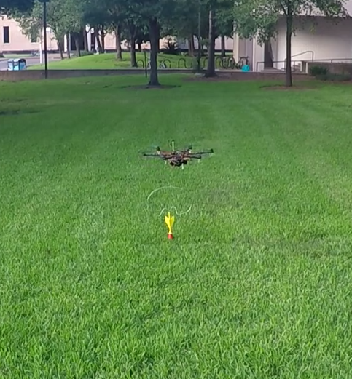
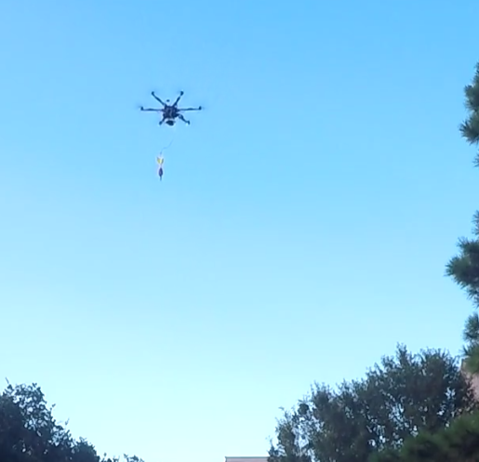
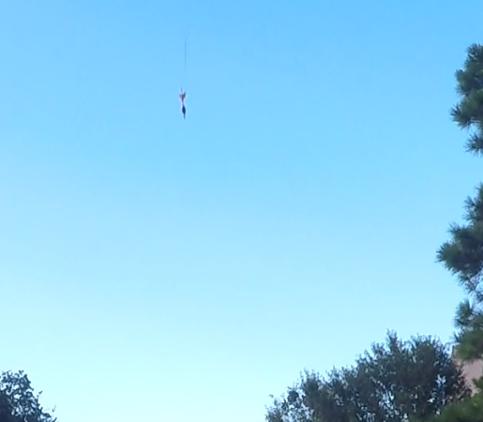
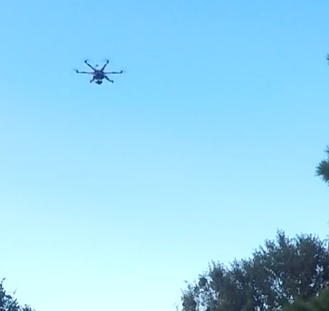
a.
b.
c.
d.
T = 30s
Deploying
T = 35s
Dropped
T = 50s
Landing
T = 10s
Retrieval

